Slide 1


Robi Joins the Team
Predicting and Collaborating with GitHub

Slide 2

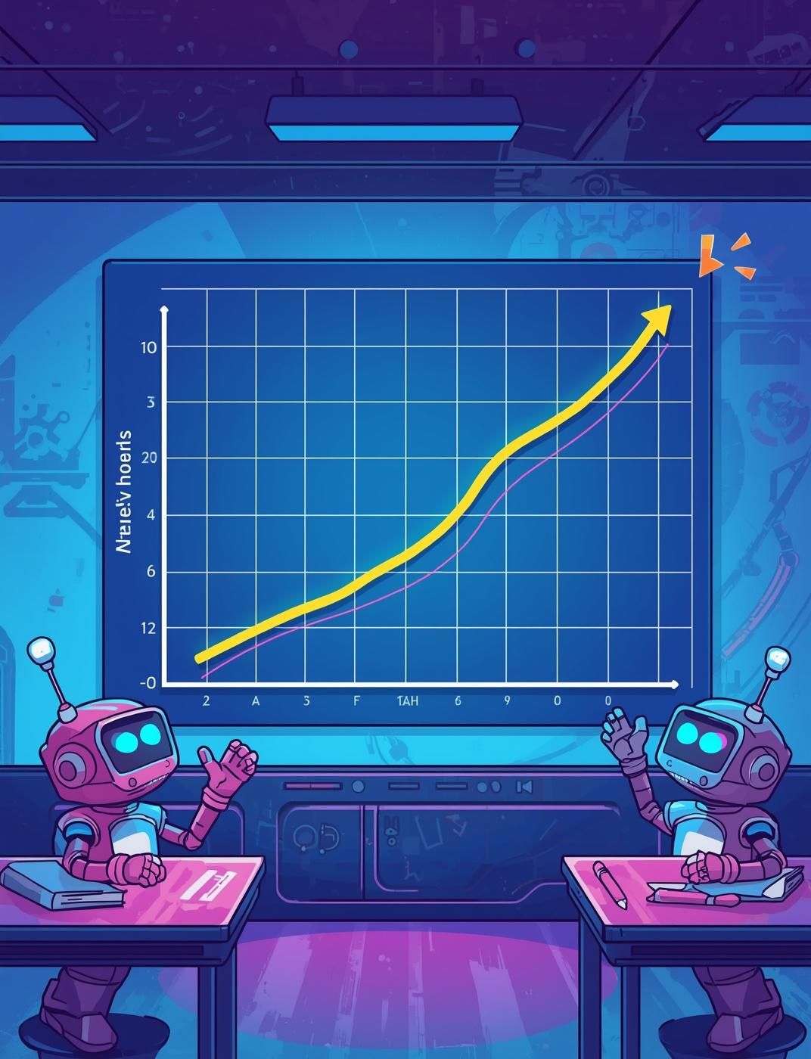
Robi Learns to Predict
Understanding Simple Linear Regression Concepts
Simple Linear Regression allows us to predict outcomes by analyzing the relationship between two variables. In this case, we will explore how study hours correlate with exam marks, represented by the formula y = m*x + c.

Slide 3

Teamwork Challenges
Understanding the Importance of Version Control
In collaborative environments, overwriting code can lead to chaos. Version control systems like Git prevent this by tracking changes, ensuring every robot’s contribution is documented and organized.

Slide 4
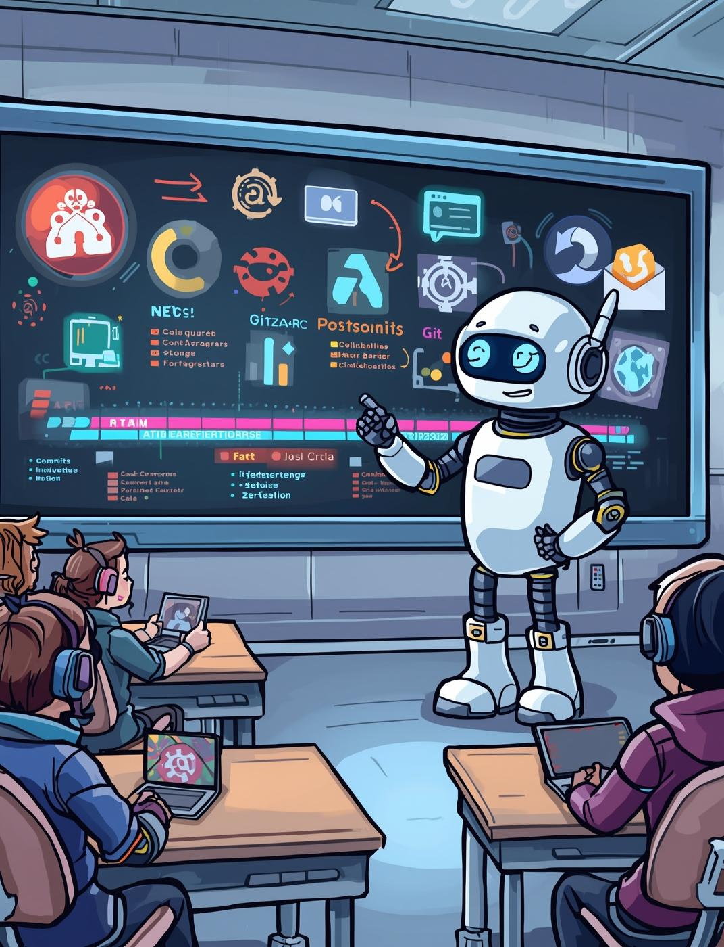
Understanding Git & GitHub
A Guide to Version Control and Collaboration
Git is a powerful version control system that helps teams track changes in their code. GitHub is an online platform for collaboration, allowing developers to work together seamlessly.

Slide 5
Robi’s Git Commands
01
02
03
git init
git add
git commit
Initializes a new Git repository
Stages changes for the next commit
Saves staged changes to the repository

Slide 6

Working on GitHub
Create Repository
Start a new repository for your project.
Repository Creation and Team Collaboration
Push Project
Upload your local changes to the repository.
Clone Repos
Download teammates’ repositories to your local machine.
Pull Requests
Propose changes and collaborate with the team.

Slide 7

The Team Project
Collaborating for Success in Data Science
In this project, Robi and his teammates work together to predict student marks using Linear Regression. By collaborating through GitHub, they effectively manage branches and share their code seamlessly.

Slide 8

Lessons Learned
Predicting Outcomes
Understand Linear Regression for making predictions.
Key insights from Robi's journey
Git Collaboration
Use Git for efficient team code management.
Effective Communication
Share insights and updates with your team.
Strong Teamwork
Collaborate to enhance project outcomes and success.

Slide 9
Homework & Practice
Upload Project
Share your Linear Regression project on GitHub.
Encouraging Practical Application of Skills
Add README
Include a README file to explain your project.
Open Pull Requests
Collaborate by opening pull requests with teammates.
Write Reflections
Document Robi’s learning experiences and insights gained.

Slide 10

A great coder shares and collaborates

